Slide 1
CS-1002 Programming fundamentals
Instructor : Aqib Rehman
aqib.rehman@isb.nu.edu.pk
Fall 2023

Slide 2
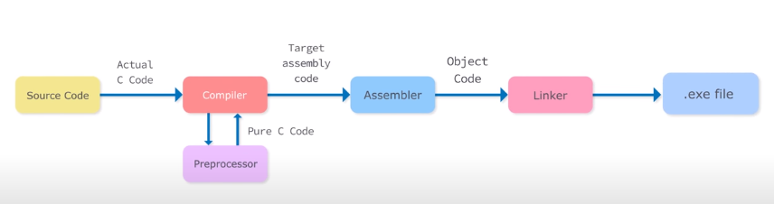

Slide 3
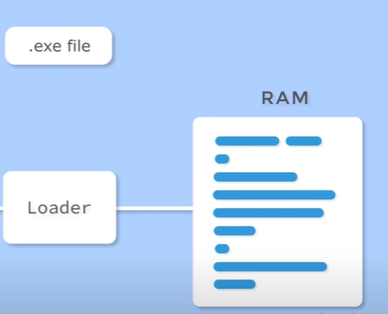

Slide 4
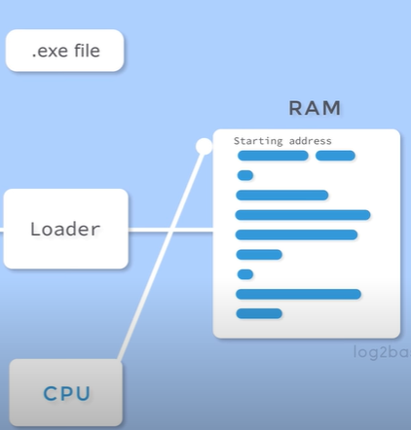

Slide 5
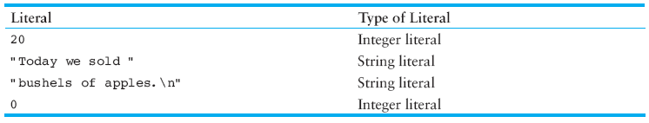
Variable and Literal
Variables represent storage locations in the computer’s memory.
Literals are fixed values that are assigned to variables.
Literals are also called constants

Slide 6
Variable
Variables stores data at particular memory location:
Name
Type
Value
Size
Lifetime + Variable scope + Variable visibility
Polarity
Address

Slide 7
1. Variable Name
Also referred to as identifiers
Rules:
You cannot use a C++ keyword (reserved word) as a variable name.
Variable names in C++ can range from 1 to 255 characters.
All variable names must begin with a letter of the alphabet (a-z, A-Z) or an underscore( _ ).
After the first initial letter, variable names can also contain letters and numbers.
No spaces or special characters are allowed.
C++ is case Sensitive. Uppercase characters are distinct from lowercase characters.

Slide 8
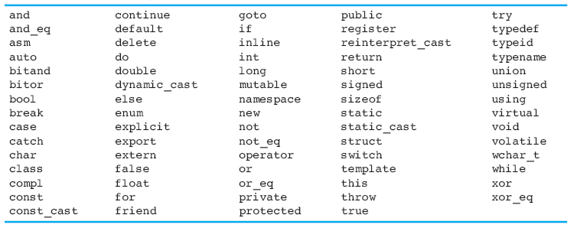
C++ Reserved Keywords

Slide 9
2. Data Types
There are many different types of data. Variables are classified according to their data type, which determines the kind of information that may be stored in them.
C++ recognizes following built-in data types which are designated by reserved words:
char
short
float
long double
unsigned int
unsigned long int
long
double
unsigned char
unsigned short
boolean

Slide 10
3. Size of Variable
Memory occupied by a variable.
Express in bytes [1 byte = 8 bits]
Depends upon the type of variable
The sizeof operator is used to determine the size of a variable.
sizeof (data type)
4. Polarity
Signed or Unsigned
Only integer or character can be signed

Slide 11
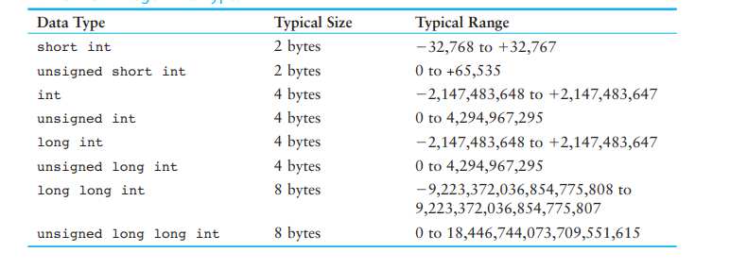
Integer Data types
Integer variables can only hold whole numbers.
Notes:
NOTE: An unsigned int variable can also be de ned using only the word unsigned.
For example, the following variable definitions are equivalent.
unsigned int days;
unsigned days;

Slide 12
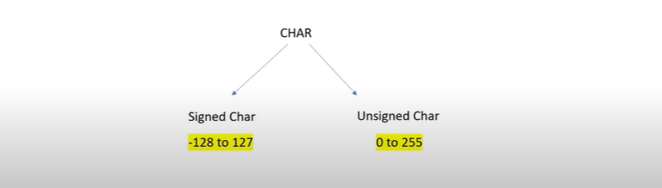
1 Byte

Slide 13
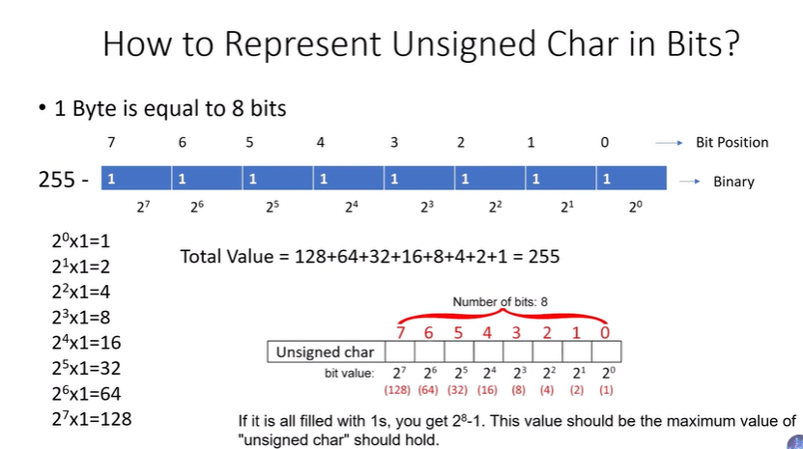

Slide 14
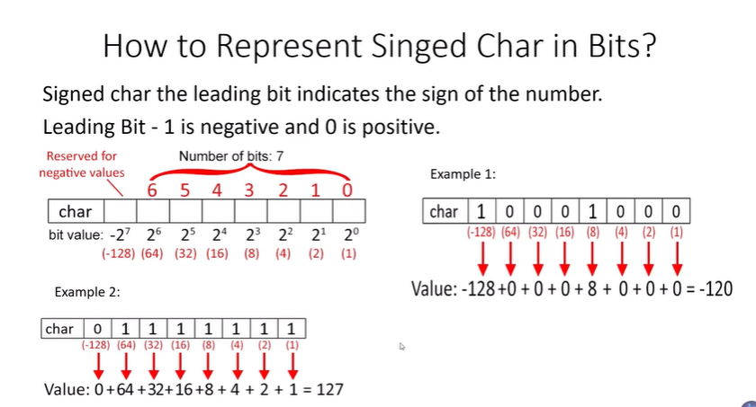

Slide 15
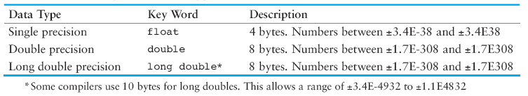
Floating-Point Data Types
Floating-point data types are used to define variables that can hold real numbers.

Slide 16
The bool Data Type
Boolean variables are set to either “true” or “false”.

Slide 17
5. Variable Lifetime: The lifetime of a variable the time period in which the variable is in memory.
6. Variable scope: A variable s scope is the part of the program that has access to the variable.
7. Variable visibility: Availability of a variable.
8. Address of variable: Where a variable reside in memory. Can be displayed using “&” operator.
Notes:
Scope & Lifetime
The scope of a declaration is the part of the program for which the declaration is in effect.
C/C++ use lexical scoping.
The lifetime of a variable or object is the time period in which the variable/object has valid memory.
Lifetime is also called "allocation method" or "storage duration."
Lifetime
Static: A static variable is stored in the data segment of the "object file" of a program. Its lifetime is the entire duration of the program's execution.
Automatic: An automatic variable has a lifetime that begins when program execution enters the function or statement block or compound and ends when execution leaves the block. Automatic variables are stored in a "function call stack".
Dynamic: The lifetime of a dynamic object begins when memory is allocated for the object (e.g., by a call to malloc() or using new) and ends when memory is deallocated (e.g., by a call to free() or using delete). Dynamic objects are stored in "the heap".
Scope
Local scope: "visible" within function or statement block from point of declaration until the end of the block.
Class scope: "seen" by class members.
Namespace scope: visible within namespace block.
File scope: visible within current text file.
Global scope: visible everywhere unless "hidden".

Slide 18
Named Constants
Literals may be given names that symbolically represent them in a program.
const qualifier is used.
const int a =10;
Remember when a value is declared const it is assigned a value immediately and that value is Read only. i.e. we can not change it.

Slide 19
Writing first Program in C++
// This is a simple C++ program. Call this file Sample.cpp.
#include <iostream>
using namespace std;
int main()
{
cout << "C++ is power programming.";
return 0;
}

Slide 20
cout and cin
Objects of iostream class
Used for taking input (cin) and for output(cout)

Slide 21
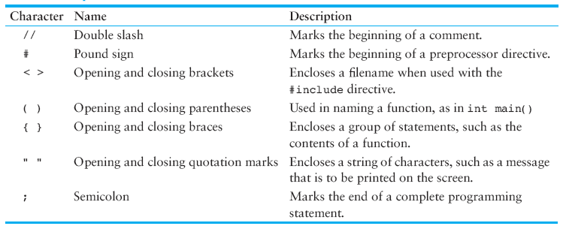
C++ Special Characters

Slide 22
Starting C++
C++ statements
Statements are fragments of the C++ program that are executed in sequence
Two types of statements
Simple statements: Single line of code
Compound Statements: Compound statements are multiple lines or curly braces-enclosed sequences of statements called blocks.

Slide 23
Simple statements
Declaration Statement
Assignment statement
Expression statement
Labels

Slide 24
Compound statements
Selection statements
If statement
If-else
Nested if else
Switch
Iteration Statements
While loop
Do while loop
For loop
Jump statements
Break
Continue
Return
Goto identifier

Slide 25
Variable deceleration and Initialization/Assignment
int a; //Declaration
a = 15; // Initialization
a = 30; //Assignment
int a=15; // Declaration + Initialization
int a, b, c, d; // Multiple Declaration
a=b=c=d=10; // Multiple Assignment
int a=b=c=d=10; //
Int a,b,c,d=10; //

Slide 26
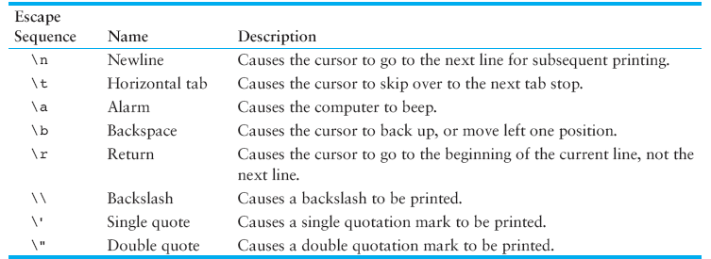
Escape sequences / Control Characters

Slide 27
Questions(???)
Thanks ☺

Slide 28
Reading Assignment
Number systems (Decimal, Octal, Binary and Hexadecimal) and their inter conversion
ASCII character Table

Slide 29
References
Book: STARTING OUT WITH C++
Chapter No.2
Author: Tony Gaddis

Slide 30
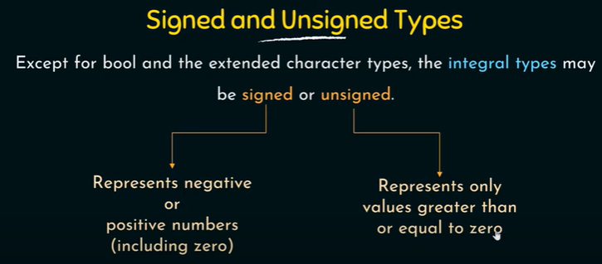

Slide 31
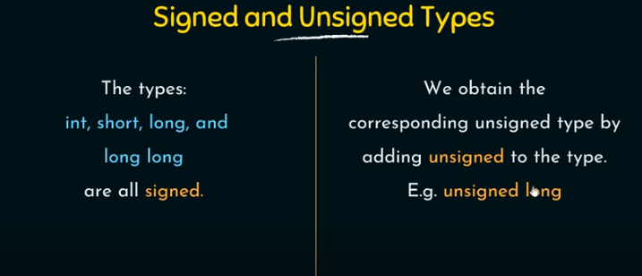

Slide 32
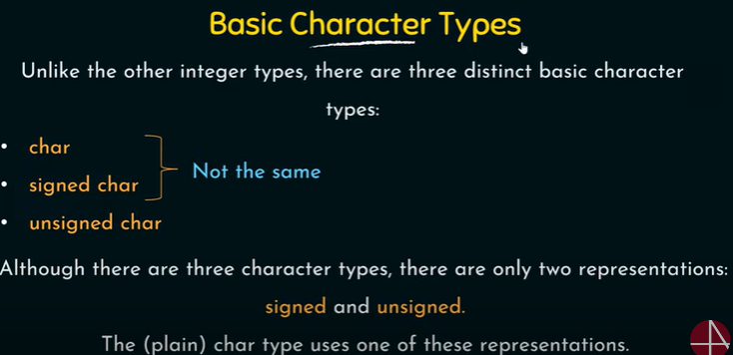

Slide 33
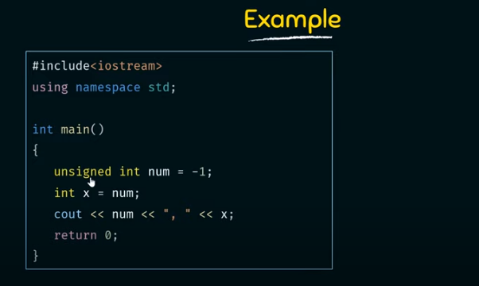

Slide 34
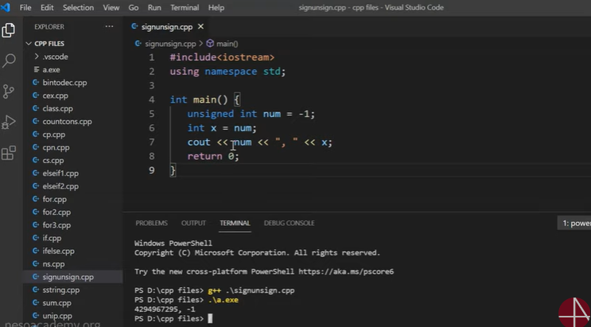

Slide 35
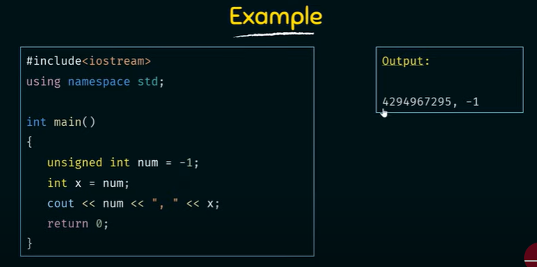

Slide 36
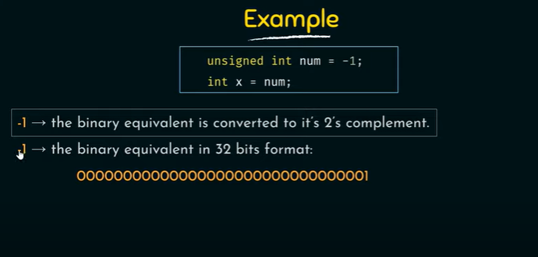

Slide 37
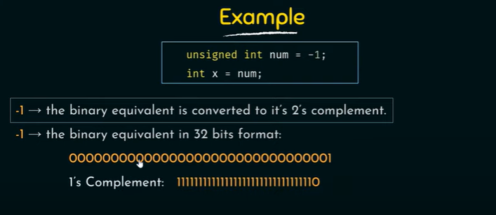

Slide 38
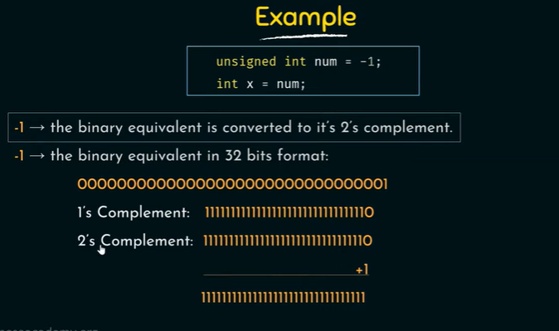

Slide 39
